Slide 1
Flow chart
Start
Set Radius
Show Welcome Screen
Select Location
Select Action
New Task
Save
Go to Home Screen

Slide 2
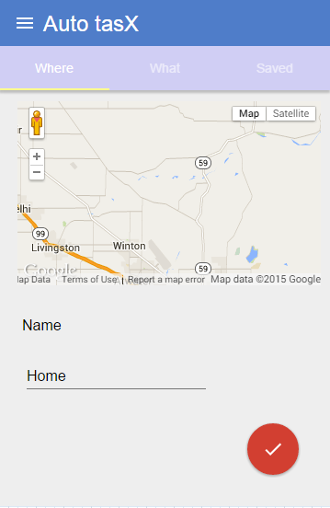
Flow chart
Start
Show Welcome Screen
New Task
Select Location
Set Radius
Select Action
Save
Go to Home Screen

